Slide 1
Intel® Unnati Industrial Training Program
Vehicle Movement Analysis and Insight Generation in a College Campus using Edge AI
Guide : Dr. M. Poongothai (Mentor), Professor, Dept. of ECE. CIT | Team Members: Sanjay V - 71762104041 Sabarivasan RT - 71762208013 Karthik Venkatesh T - 71762208015 Edwin Nova A - 71762208023

Slide 2
Problem Statement
Managing vehicle movement and parking on a college campus presents numerous challenges. To enhance campus security and management, an intelligent system is needed to analyze vehicle movement, monitor parking occupancy, and match vehicles to an approved database.
Challenges:
Inefficient vehicle movement tracking.
Difficulty monitoring parking occupancy.
Identifying unauthorized vehicles.

Slide 3
Unique Idea Brief (Solution)
The solution aims to improve traffic management and congestion control on college campuses using five camera modules, each using advanced machine learning techniques including the YOLOv8 model, to track vehicles, detect unauthorized parking, monitor parking availability, and analyze available spaces. Five camera modules have been used to implement all the functionalities of the proposed system.
The first module, Cam 1, uses optical character recognition to track vehicles entering and exiting the campus. Cam 2 detects unauthorized vehicles, alerting owners and promoting parking adherence.
Cam 3 monitors vehicle entries, providing real-time traffic patterns. Cam 4 monitors congestion in parking areas, enabling prompt interventions. Cam 5 analyzes available parking slots, reducing time spent searching for parking. All data is integrated using Edge AI.

Slide 4
Features Offered
Real-time Vehicle Detection and Tracking
Number Plate Recognition (OCR)
Unauthorized Parking Detection
Traffic Pattern Analysis
Parking Slot Availability Monitoring
Real-time Parking Slot Updates
Edge AI Processing
Cloud-based Data Storage and Management
Historical Data Analysis
Integration and Scalability
Enhanced Campus Security and Efficiency

Slide 5
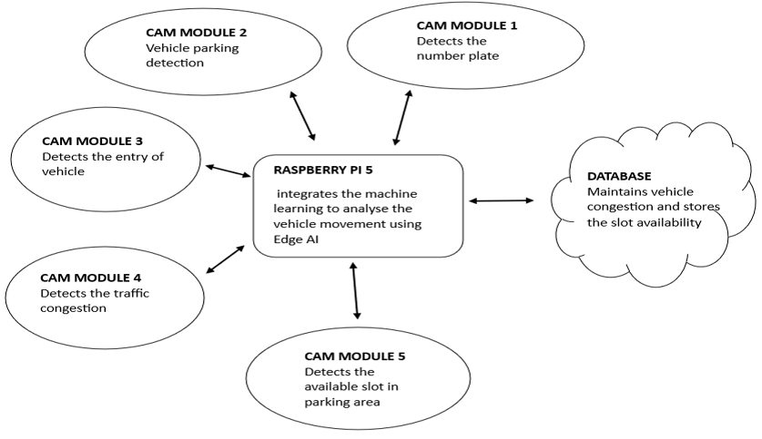
Architecture Diagram

Slide 6
Process flow
Start
Analyze & allocate the parking slot using Edge AI
Number plate detection
Store the datas in database
Increase the count of vehicle occurrence
Update
the data of slot availability and count value in database
Check whether the car is in unrestricted area or not
End

Slide 7
Technologies used
Camera Modules
Raspberry Pi 5
Aws Cloud (Database Management)

Slide 8
Team members and contribution:
TEAM MEMBERS NAME | CONTRIBUTION
SANJAY V | Trained the number plate detection and coordinated the work with the team members
KARTHIK VENKATESH T | Trained the unauthorised area detection and labelled the model and detecting the car
SABARIVASAN RT | Trained the parking slot availability and integerated various ML algorithm
EDWIN NOVA A | Trained the model to store the frequencies of car and store the values in database

Slide 9
Conclusion
The system improves campus traffic management with real-time vehicle tracking, optimizing traffic flow and parking efficiency. It enhances security by detecting unauthorized parking and accurately identifying vehicles. Data analysis aids decision-making, while the scalable architecture allows for easy integration with other systems. Overall, edge AI processing and cloud-based management ensure a responsive and efficient operation.

